Slide 2
The 30-Day Per Month Prophetic Count of God
The Bible Christians
of God
Bible Study Class
Presents
THE SET FEAST CALENDAR OF GOD

Slide 3
BASIC AGREEMENT ABOUT THE SEVENTH MONTH

Slide 4
The 30-Day Per Month Prophetic Count of God
For those of us who believe in Prophecy and in observing the LORDS Feast, WE CAN ALL AGREE on the following Prophecies concerning the return of Jesus to the earth:
Everyone that is left of all the nations of the earth will be keeping the Feast of Tabernacles on the earth with the LORD in Jerusalem on the 15th day of the 7th Month
( Zech 14:16-18; Lev 23:33-34)
5 days before that on the 10th Day of the 7th month was the Day of Atonement, the day of affliction and reconciliation of the true nation of Israel and a Jubilee in our land and the confessions of the Gentiles.
(Zech 14:1-3,12-15, 9:14; Lev 23:26-30,25:9, Jer 16:19)
10 days before that on the 1st Day of the 7th Month is the memorial Blowing of the Trumpet Jesus will have a holy meeting with his saints in the air to bring them to the mount Olivet, by the 7th trumpet thus bringing the 1st Resurrection of the dead and the changing of the righteous living.
(Zech 14:1-7; Lev 23:23-25; 1 Thes 4:14-18 1 Cor 15:51-52, Rev 11:15,18)
we have 2 questionS: Do we believe his Prophecies will be fulfilled as he set them ? and what calendar did the LORD use to bring us to these events and to observe his feast ?

Slide 5
The Luna Calendar or His 30-Day Per Month Prophetic Count?

Slide 6
The 30-Day Per Month Prophetic Count of God
The Prophetic Count used by the LORD to bring us to the events of Zechariah 14th Chapter is the same Count that we should be using today, it’s revealed in vivid detail in the book of Revelations
Prior to Jesus return to the earth in Zechariah 14th Chapter we can read about the time period that precedes him in Revelation 11:1-5.
But the court which is without the temple leave out and measure it not; for it is given unto the Gentiles: and holy city shall they tread under foot FORTY and TWO MONTHS and I will give power unto my two witnesses and they shall prophesy a THOUSAND TWO HUNDRED and THREE SCORE DAYS, cloth in sackcloth.
42 months divided by 1260 days = 30 days in every month according to THE PROPHECY
And on the day that he comes back pay close attention to Rev 11: 15
And the seventh angel sounded; and there were great voices in heaven saying, The kingdoms
of this world are become the kingdom of our Lord and of his Christ and he shall reign forever
The LORD brought us to the observance of the Feast of Tabernacle
by a 30 day per month Prophetic Count if you believe the Prophecy

Slide 7
The 30-Day Per Month Prophetic Count of God
The LORD will bring us to the events of Zechariah 14th and the observance of the Feast of Tabernacle by a 30 day per month if you believe his prophets.
This 30-day per month prophecy is repeated several times in the Book of Revelations and throughout the Bible, but before we go to the other places let’s take another look at this Prophecy in Revelations the 12th Chapter:
(v.6)And the woman fled into the wilderness where she hath a place prepared of God that they should feed her there a THOUSAND TWO HUNDRED and THREESCORE DAYS.
1260 days or 42 months which is 3 ½ years
(v.14)And to the woman were given two wings of a great eagle that she might fly into the wilderness into her place where she is nourished for a TIME, and TIMES, and a HALF A TIME, from the face of the serpent.
Time is 1 year, Times is 2 years, ½ Times is 6 months = 3 years 6 months
Or
1260 days which equals 42 month (Rev 11:2, 13:5-7) which gives us a consistent 30 days per month Prophecy which is not the case with the Luna Calendar.

Slide 8
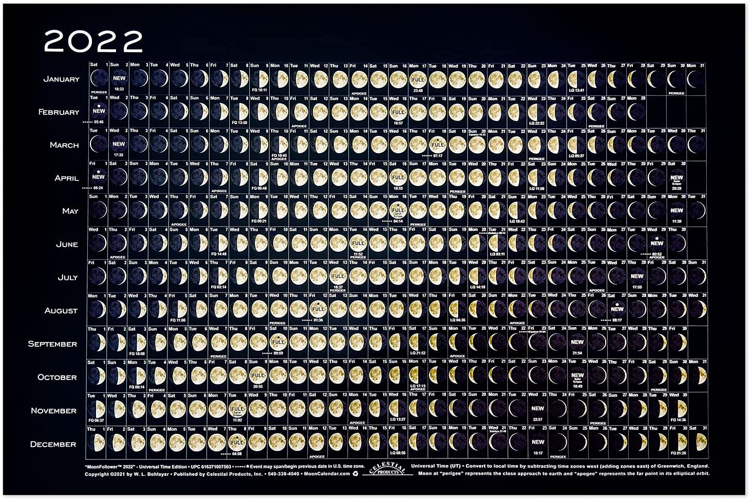
EQUINOX AND THEN CAME ABIB 1 NEW MOON
LUNAR CALENDAR
THE 30TH DAY OF A MONTH

Slide 9
JESUS USES THE 30-DAY Per Month PROPHETIC COUNT

Slide 10
The 30-Day Per Month Prophetic Count of God
The prophesy in the book of revelations shows how the LORD will used a 30 day per month prophecy to bring us to the coming of his Kingdom in the 7th month and to observe of the Feast of Tabernacle. Let us now confirm this is indeed a PROPHECY by Jesus himself:
When ye therefore shall see THE ABOMINATION OF DESOLATION spoken of by Daniel the prophet Stand in the holy place(whoso readeth, let him understand) THEN LET THEM WHICH BE IN JUDEA FLEE into the mountains. -Mat 24:15-16
Let us now go and read THIS PROPHECY : Daniels 12:9-11
And he said, Go thy way, Daniel: for the words are closed up and sealed till the time of the end. Many shall be purified, and made white, and tried; but the wicked shall do wickedly: and none of the wicked shall understand; but the wise shall understand.
And from the time that the daily sacrifice shall be taken away, and THE ABOMINATION THAT MAKETH DESOLATE set up, there shall be a THOUSAND TWO HUNDRED and NINTY DAYS
Now what is the difference between 1260 days and 1290 days?
30 days or 1 month in the Prophetic Count of God
30 days is what Jesus was conveying or 1 month in the Prophetic count of God.
This is how long we have to flee before the 42 months of war on the saints begins by the beast-Rev 13:5-7.

Slide 11
Did God show Moses His 30-Day Per Month Prophetic Count? The Set Feast Calendar of God? The Book of Genesis

Slide 12
The 30-Day Per Month Prophetic Count of God
Yes, In the passage concerning Noah and the great Flood. God showed Moses his Prophetic Count because it was the End of the world as Noah knew it in a time of great wickedness.(2 Pet 2:5,3:6)
In the six hundredth year of Noah’s life, IN THE SECOND MONTH, THE SEVENTEENTH DAY OF THE MONTH, the same day were all the fountains of the deep broken up and the windows of heaven were opened and it rained upon the earth forty days and forty nights In the selfsame day entered Noah and Shem, and Ham and Japheth, and the sons of Noah and Noah’s wife and the three wives of his sons with them, into the ark.
Now at this point Noah’s ark was filled with all that God would save alive. Both of Noah and his family and all the animals that the LORD brought unto Noah..
And the waters prevailed upon the earth an HUNDRED and FIFTY DAYS- Gen 7:24.
Now remember that it was the 17th DAY of THE SECOND MONTH from the start
PLUS an HUNDRED and FIFTY DAYS.

Slide 13
The 30-Day Per Month Prophetic Count of God
(continuation)
Now in this passages concerning Noah and the great Flood the 30-Day Per Month Prophetic Count of God is revealed.
The fountains also of the deep and the windows of heaven were stopped, and THE RAIN FROM HEAVEN WAS RESTRAINED; and water returned from off the earth continually and after the end of THE HUNDRED and FIFTY DAYS the waters were abated. And the ark rested in the SEVENTH MONTH, on the SEVENTEENTH DAY of THE MONTH, upon the mountains of Ararat. Gen 8:2-4
Now notice these three points concerning the time from the 17th DAY of THE SECOND MONTH to the 17th DAY of THE SEVENTH MONTH.
1-They couldn’t see the moon to use as a marker because of the clouds
that rained
2-They could only measure time by the changing of night into day
and day into night thru the window of the ark.
3- When you subtract 2 months from 7 months, the passing of 30 days has occurred five times, thus rending 150 days or as it is written “on the 17th day of the 7th month

Slide 14
The 30-Day Per Month Prophetic Count of God
(continuation)
Now let’s see how Jesus likens the Prophecy of his return to the Days of Noah.
FOR AS IT WAS IN THE DAYS OF NO’E so shall also the COMING OF THE SON OF MAN BE. Mat 24:37
Now let’s see if he was speaking of the spiritual condition only.
THE GREAT DAY OF THE LORD is near, it is near, and hasteth greatly, even the voice of the day of the LORD the mighty man shall cry bitterly that day is a day of wrath a day of wasteness and desolation. A DAY OF DARKNESS and GLOOMINESS, a DAY OF CLOUDS and THICK DARKNESS a DAY OF THE TRUMPET and AGAINST THE FENCED CITIES and AGAINST THE HIGH TOWERS- Zep 1:14-16
Now think about the comparison
Back in the Great Flood the RAIN WAS NOT STOPPED FOR
An 150 DAYS, The sky was DARKEN BECAUSE OF THE CLOUDS that brought
The rain and GLOOMINESS all of the fenced cities were drowned and there WAS
NO HIGH TOWER THAT ANY MAN SAVE HIMSELF back in the days of Noah

Slide 15
Did God show Moses His 30-Day Per Month Prophetic Count? The Book of Numbers

Slide 16
The 30-Day Per Month Prophetic Count of God
God showed Moses the Luna Calendar and then Set Feast 30-Day Per Month Calendar in the Book of Numbers
God starts with the daily, the weekly, the monthly burnt offerings in the 28th Chapter of Numbers. Then he begins his annual Set Feast in the same chapter fulfilled by Jesus in his first coming . The feast will be fulfilled by Jesus in his second coming in 29th Chapters of the book of Number.
God reveals to Moses In Numbers 28:1-16
ONE CALENDAR UNDER THE LEVITICAL PRIESTHOOD containing the following:
The DAILY sacrifices Verses 3-8,
The WEEKLY sacrifices performed on the 7th day Sabbath Verses 9-10 .
The MONTHLY sacrifices done at the beginning of every
month called the burnt offering of the month Verses 11-15
also known as the New Moons ( 1Chr 23:31,Ezr 3:5-6) or THE LUNA CALENDAR
The Set Feast Calendar of God
God now reveals to Moses starting at verse 16 -30 THE 30-DAY Per MONTH PROPHETIC COUNT containing a part of the SET FEAST of THE LORD and the remaining Set Feast to be fulfilled starting at the top verse of the 29th Chapter which OCCURS ANNUALLY.

Slide 17
LUNAR CALENDAR
THE BURNT OFFERING OF A MONTH

Slide 18
The Set Feast Calendar of God
(3) Num 29:39 These things ye shall do unto the LORD in YOUR SET FEAST, BESIDES your
Your vows and your free will offerings, for your burnt offerings and for your meat offerings
And for your drink offerings, and for your peace offerings.
Now the 30 Day per month Count Separates The Set Feast of The Lord 5 times from the Lunar Calendar
1 Chronicle 23:31 And to offer all burnt sacrifices unto the Lord in the sabbaths, in the new moons, and on the set feasts, by number, according to the order commanded unto them, continually before the Lord:
2 Chronicles 31:3 He appointed also the king's portion of his substance for the burnt offerings, to wit, for the morning and evening burnt offerings, and the burnt offerings for the sabbaths, and for the new moons, and for the set feasts, as it is written in the law of the Lord.
Ezra 3:5 And afterward offered the continual burnt offering, both of the new moons, and of all the set feasts of the Lord that were consecrated, and of every one that willingly offered a freewill offering unto the Lord.
Neh 10:33 For the shewbread, and for the continual meat offering, and for the continual burnt offering, of the sabbaths, of the new moons, for the set feasts, and for the holy things, and for the sin offerings to make an atonement for Israel, and for all the work of the house of our God.

Slide 19
The Feast Calendar of God
Now notice how The Set Feast of The Lord is called the solemn feast SEPARATED from the NEW MOONS OF THE Lunar Calendar
2 Chrn 2:4 Behold, I build an house to the name of the Lord my God, to dedicate it to him, and to burn before him sweet incense, and for the continual shewbread, and for the burnt offerings morning and evening, on the sabbaths, and on the new moons, and on the solemn feasts of the Lord our God. This is an ordinance for ever to Israel.
2 Chrn 8:13 Even after a certain rate every day, offering according to the commandment of Moses, on the sabbaths, and on the new moons, and on the solemn feasts, three times in the year, even in the feast of unleavened bread, and in the feast of weeks, and in the feast of tabernacles.
Exodus 23:14-16¹⁴ Three times thou shalt keep a feast unto me in the year.¹⁵ Thou shalt keep the feast of unleavened bread: (thou shalt eat unleavened bread seven days, as I commanded thee, in the time appointed of the month Abib; for in it thou camest out from Egypt: and none shall appear before me empty:)¹⁶ And the feast of harvest, the firstfruits of thy labours, which thou hast sown in the field: and the feast of ingathering, which is in the end of the year, when thou hast gathered in thy labours out of the field.

Slide 20
The FEAST FEAST CALENDAR of God
THREE KEY VERSES TO KEEP IN MIND
(1) Num 28: 14 This is THE BURNT OFFERING OF EVERY MONTH
(2) Num 29:6 BESIDES THE BURNT OFFERING OF THE MONTH ******
(3) Num 29:39 These things ye shall do unto the LORD in YOUR SET FEAST, BESIDES your
Your vows and your free will offerings, for your burnt offerings and for your meat offerings
And for your drink offerings, and for your peace offerings.
HERE’S AN OVERVIEW OF THE SET FEAST BASED ON HIS SET 30 DAY Per PROPHETIC COUNT
KEY EVENTS TO KEEP IN MIND

Slide 21
The Luna Calendar (Levitical Priesthood), Solar and 30-Day Per Month Prophetic Count of God (side by side)
Notice the variations of the Luna Calendar
verses the consistency of the Prophetic Count

Slide 22
ERROR
ERROR
ERROR
ERROR
ERROR
12

Slide 23
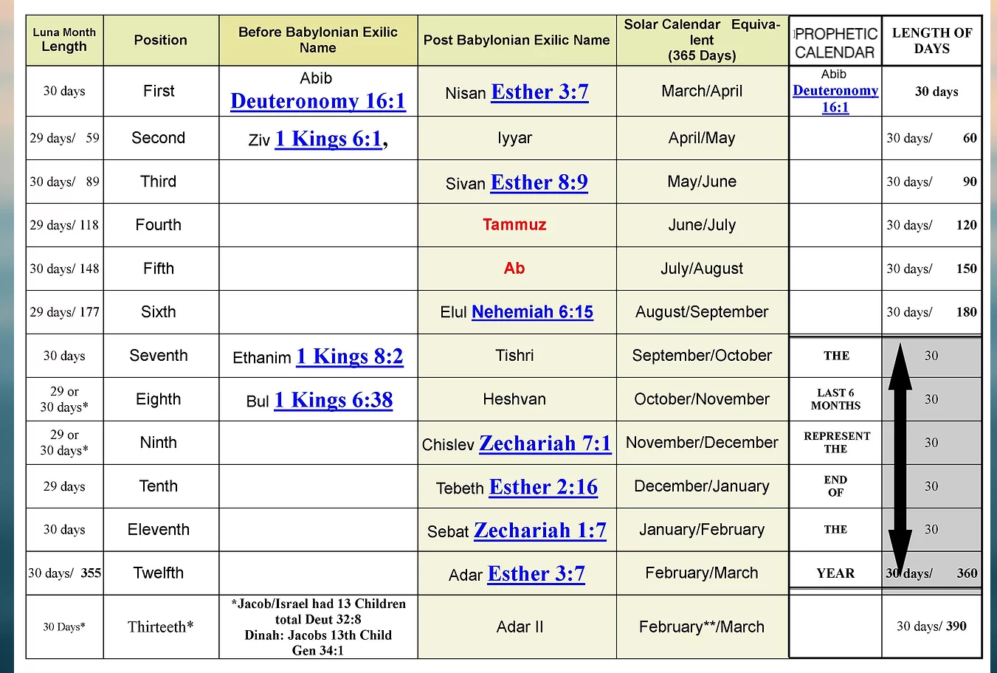
LUNA CALENDAR NAMES FOUND IN THE BIBLE

Slide 24
LUNAR CALENDAR
THE BURNT OFFERING OF A MONTH

Slide 25
THE LORD REQUIREMENT FOR HIS SET FEAST AND The 30-Day Per Month Prophetic Count of God

Slide 26
The 30-Day Per Month Prophetic Count of God
The LORD PROCLAIMS in Leviticus 23rd chapter saying unto Moses THESE ARE MY FEAST and those who believe in keeping THE FEAST OF THE LORD will refer to this chapter . The LORD even said THREE TIMES IN A YEAR shall all thy males APPEAR BEFORE ME concerning HIS FEAST in Exodus 23:14-17 and Deuteronomy 16:17
However, it is written
When ye come to appear before me WHO HATH REQUIRED THIS
at your hand to tread my courts? Bring no more vain oblation, incense is an
Abomination unto me; THE NEW MOONS and sabbaths, the CALLING OF
ASSEMBLY, I cannot away with ;IT IS INIQUITY, even THE SOLEMN MEETING.
YOUR NEW MOONS and YOUR APPOINTED FEAST MY SOUL HATETH: they
Are a trouble unto me; I am weary to bear them- Isaiah 1:12-14
Now here we see the LORD HATING THE PRACTICE of using THE NEW MOONS or THE
LUNA CALENDAR to appoint FEAST unto him ; WHICH was under the levitical priesthood
HE ONLY APPOINTED ONE NEW MOON; that we are to OBSERVE THE MONTH ABIB
Deut 16:1 FOUND IN THE LAW OF THE LORD
by which he SET HIS FEAST according to 30 day per month count which is a 360 days per year
ETHANIM The NEW MOON of the 7th month IS NOT A FEAST APPOINTED BY GOD

Slide 27
The 30-Day Per Month Prophetic Count of God
Now lets take a closer look at the count the LORD requires to keep HIS FEAST every year and thus ensuring
that Isaiah 1:12-14 does not apply to us the Servants of God
The first month Abib starts the count of the 360 day Prophetic Count of God and it contains 3 of the early Feast of LORD. It is the beginning of the Year according to Ex 12:1 it is also called Nisan –Est 3:7
Now there are a total of 7 yearly Feast days to be observed according to Lev 23:41
from the 1st month to the 7th month as listed in Leviticus 23:4-40
1-The Passover
2-1st & Last day of Unleavened Bread*
3-The Pentecost
4-The Memorial Blowing of the Trumpet
5-The Day of Atonement
6-The Feast of Tabernacles *
7-The 8th Day*
The FIRST THREE FEAST fall within the first 6 MONTHS OF THE LORDS PROPHETIC
COUNT or within 180 days WHICH IS AN HALF A YEAR TO THE LORD -6 x 30 = 180
The LAST FOUR FEAST are in THE END OF THE YEAR or starting on DAY 181 which is the
Start of the 7th month according to THE COUNT OF GOD
Being 180 + 180 = 360 days
..And in the Feast of Ingathering * WHICH IS IN THE END OF THE YEAR- Ex 23:16

Slide 28
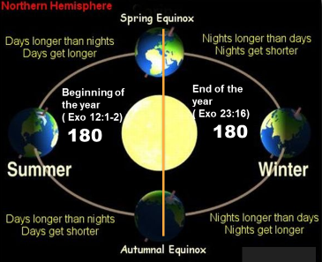
360 DEGREE CIRCLE= 360 DAYS

Slide 29
The 30-Day Per Month Prophetic Count of God
Now let’s see what happens when a Minister sets aside a day and says it is a Feast unto the Lord that he didn’t appoint.
Exodus 32:3-7
³ And all the people brake off the golden earrings which were in their ears, and brought them unto Aaron.⁴ And he received them at their hand, and fashioned it with a graving tool, after he had made it a molten calf: and they said, These be thy gods, O Israel, which brought thee up out of the land of Egypt.⁵ And when Aaron saw it, he built an altar before it; and Aaron made proclamation, and said, To morrow is a feast to the Lord.⁶ And they rose up early on the morrow, and offered burnt offerings, and brought peace offerings; and the people sat down to eat and to drink, and rose up to play.⁷ And the Lord said unto Moses, Go, get thee down; for thy people, which thou broughtest out of the land of Egypt, have corrupted themselves:
Now what does the New Testament also call their action
1 Corinthians 10:7
⁷ Neither be ye idolaters, as were some of them; as it is written, The people sat down to eat and drink, and rose up to play.

Slide 30
THE CONCLUSION OF THE MATTER

Slide 31
The 30-Day Per Month Prophetic Count of God
This IS our hope and prayer for ALL THAT SEEK THE TRUTH IN CHRIST JESUS AND THE UNITY OF GOD’S PEOPLE
IN THE KEEPING OF THE LORD’S HOLY FEAST uncorrupted
We know prophecy, but you’ve never been taught the 30-Day Per Month Prophetic Count of God consider what we’ve read together out the Holy Bible from the LAW to the Testimony,
Consider that all the SET FEAST OF THE LORD have a prophecy linked to them.
Let no man therefore judge you in meat or drink, or in respect of an holyday, or of the new moon, or of the Sabbath days: WHICH ARE A SHADOW OF THINGS TO COME; but the body [ meaning the church] is of Christ (Col 2::16-17)
DO WE BELIEVE GOD’S PROPHESIES
Do the Math, Do the Math, Do the Math
BECAUSE THE NUMBERS DON’T LIE! AND NEITHER DOES HIS PROPHECY
The un-appointed Ethanim NEW MOON is 178 days from the Appointed Moon ABIB
That Doctrine teaches the Feast according to the NEW MOONS
THE LORD HATES THAT (Isa 1: 12-14)
Let us hear the conclusion of the matter
FEAR GOD and KEEP HIS COMMANDMENTS
For this is the WHOLE DUTY OF MAN.

Slide 32
The Summary Event Chart of The Set Feast of The LORD Leviticus 23rd Chapter
The Bible Christians
of God
Bible Study Class
Presents

Slide 33
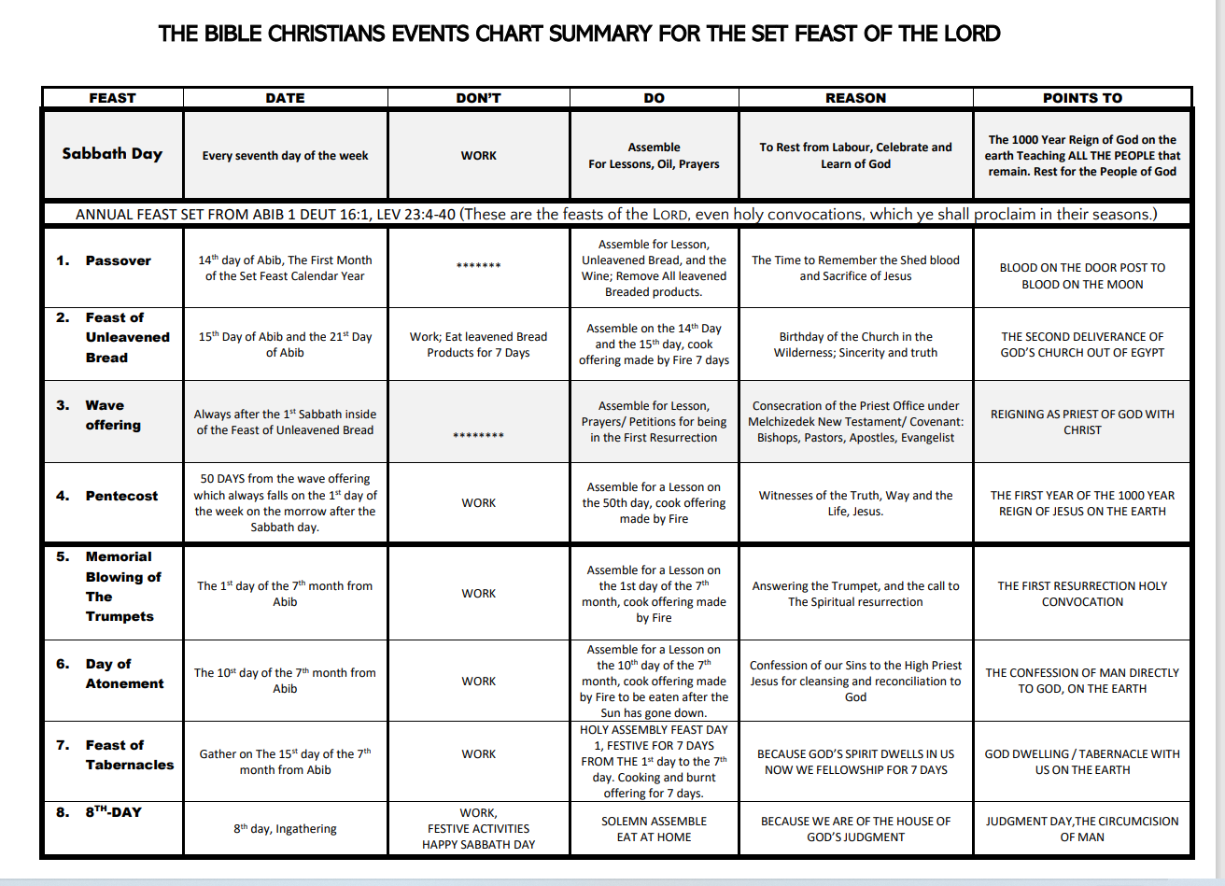

Slide 42
The Summary Event Chart of The Set Feast of The LORD Leviticus 23rd Chapter
The Bible Christians
of God
Bible Study Class
Presents

