Slide 2
DEPICTIONS THE WORLD GIVES US OF THE PERSONS IN THE BIBLE

Slide 3
OR ARE THESE DEPICTIONS CLOSER TO THE TRUE COLOR OF THE PERSONS FOUND IN THE BIBLE?

Slide 4
PICTURES FROM THE WALLS FOUND INSIDE THE TOMBS OF THE EGYPT PYRAMIDS

Slide 6
PHAROAH CHASING ISRAELITES

Slide 7
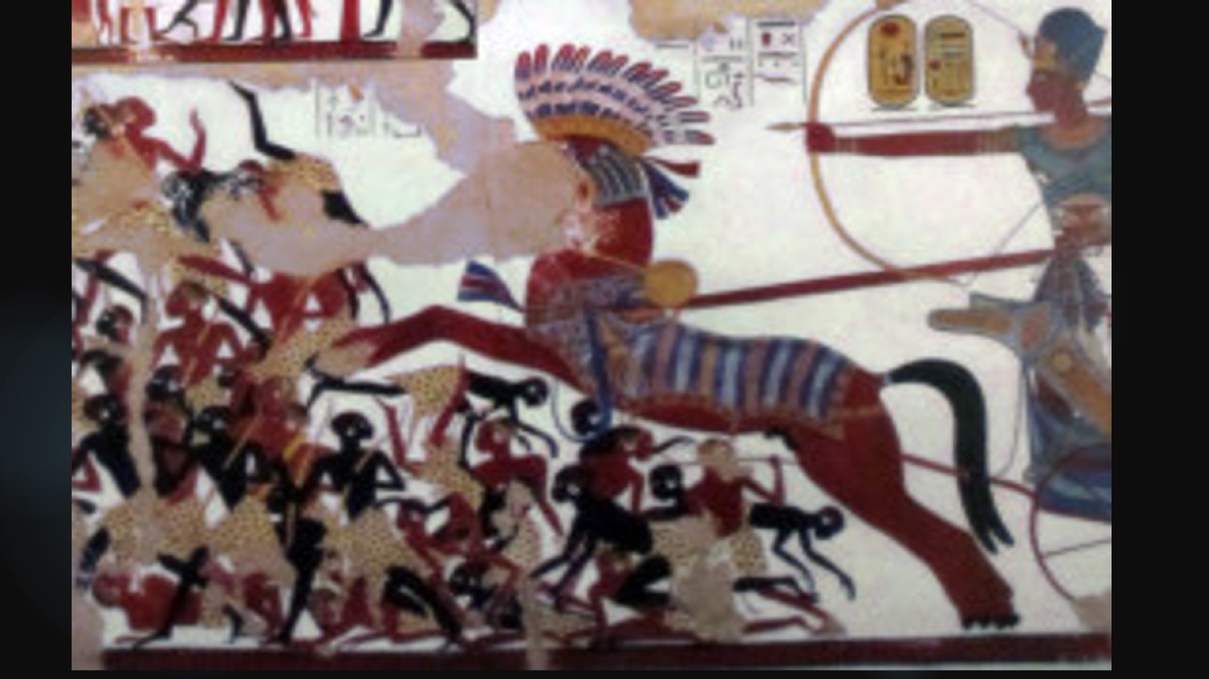

Slide 8
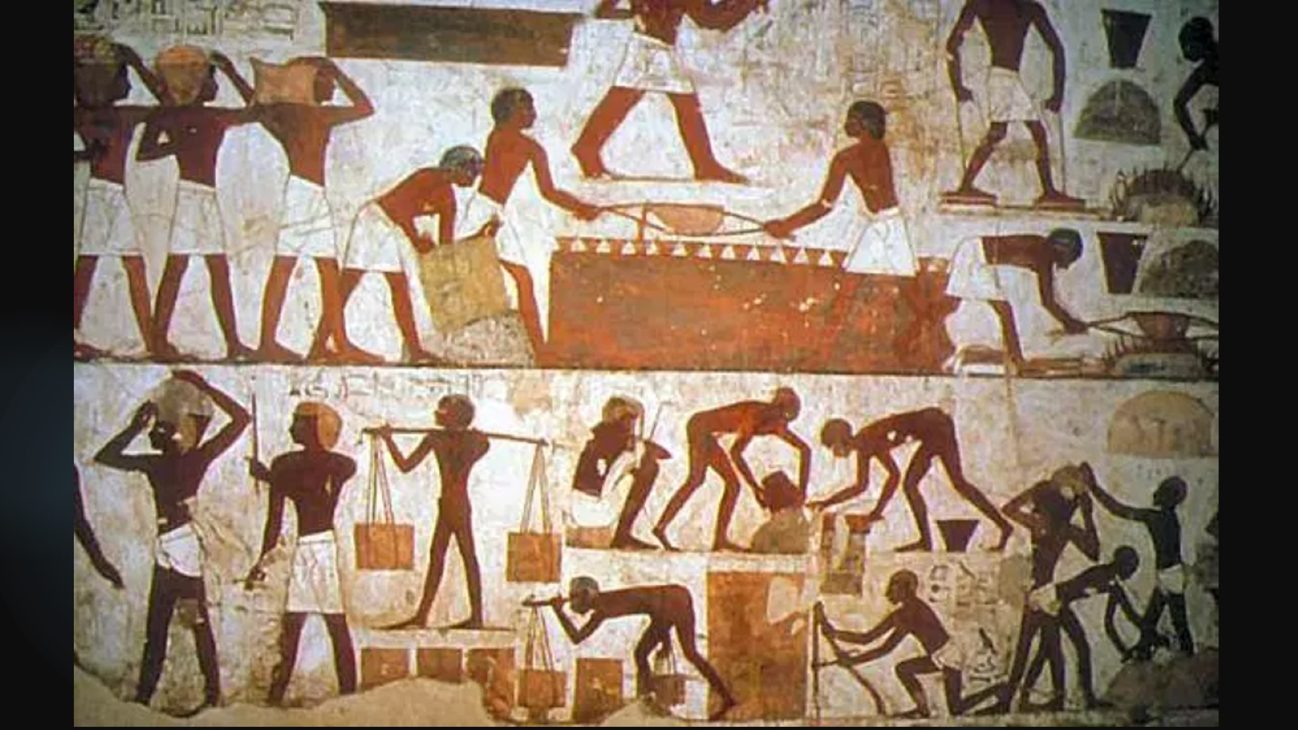

Slide 9
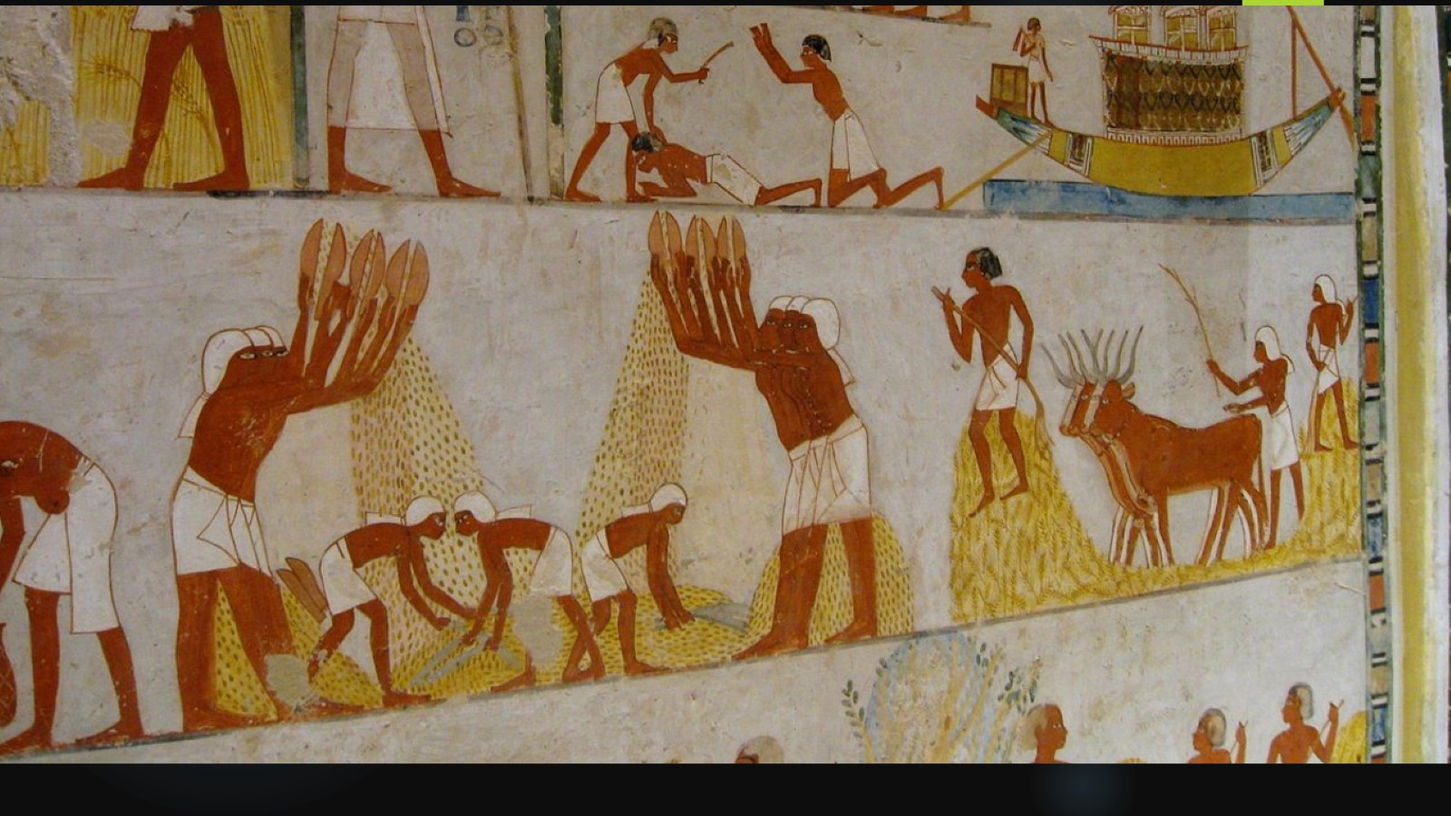

Slide 10
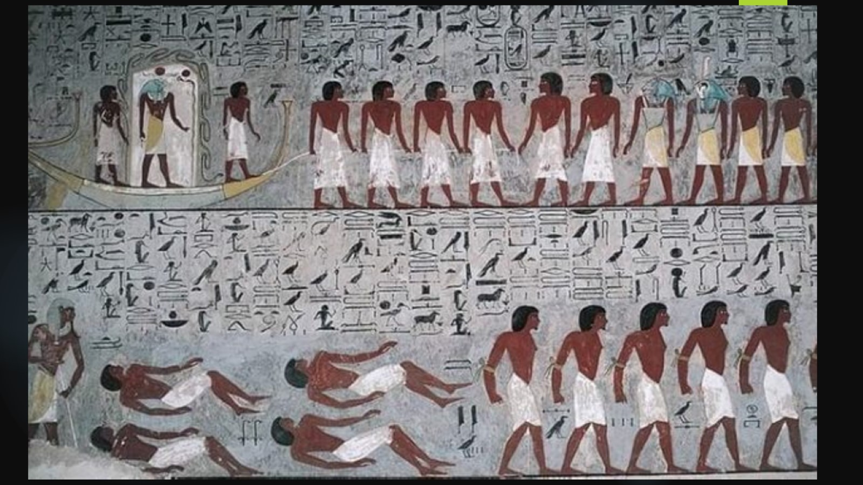

Slide 11
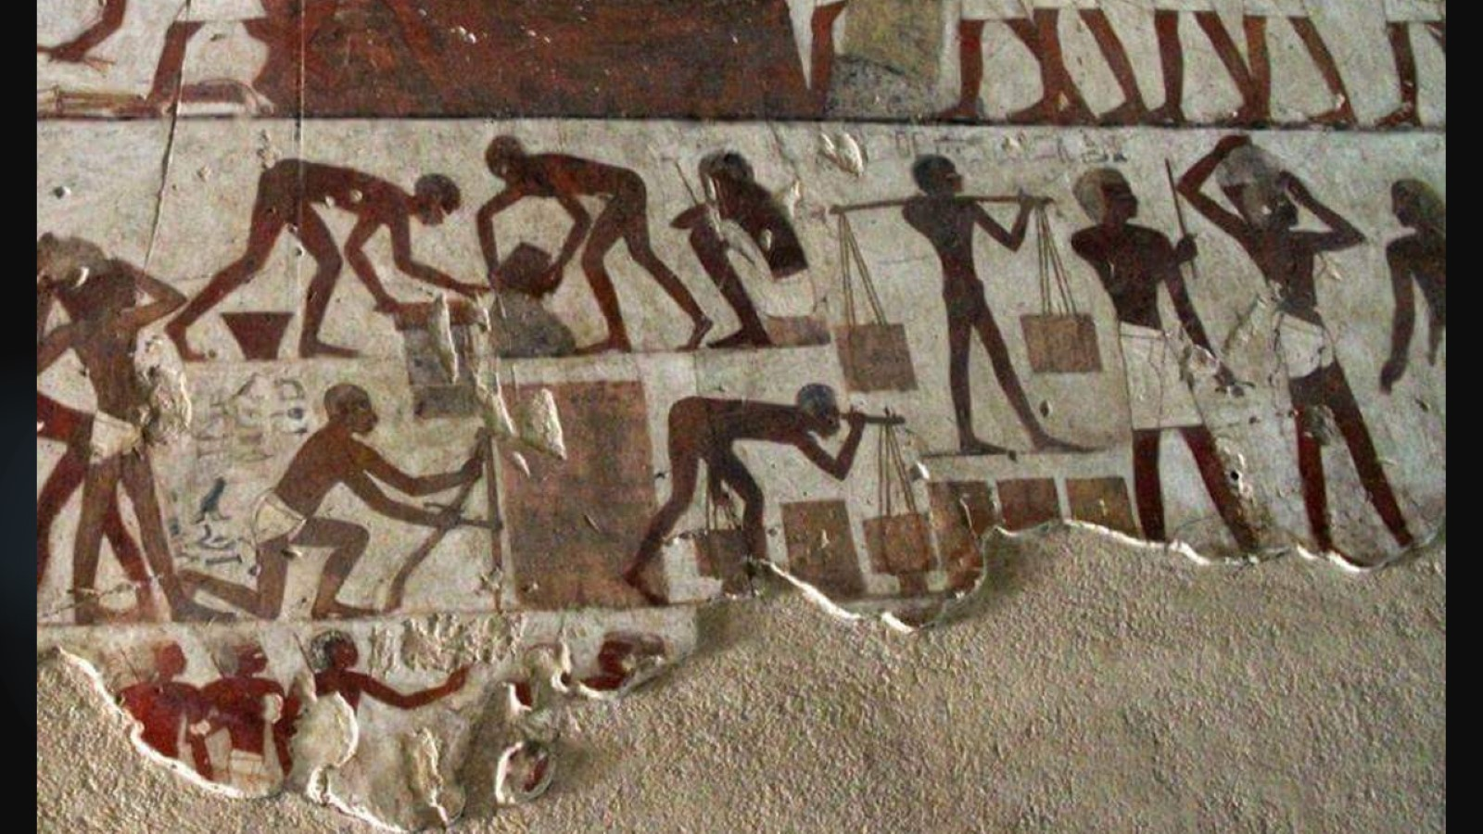

Slide 12
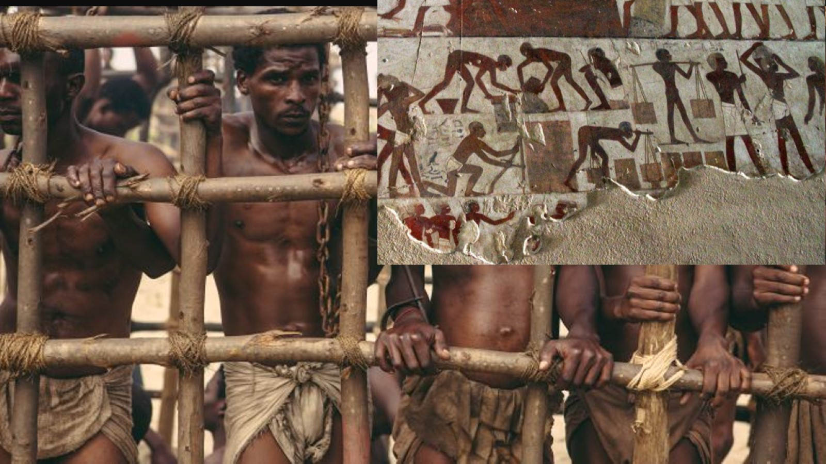

Slide 13
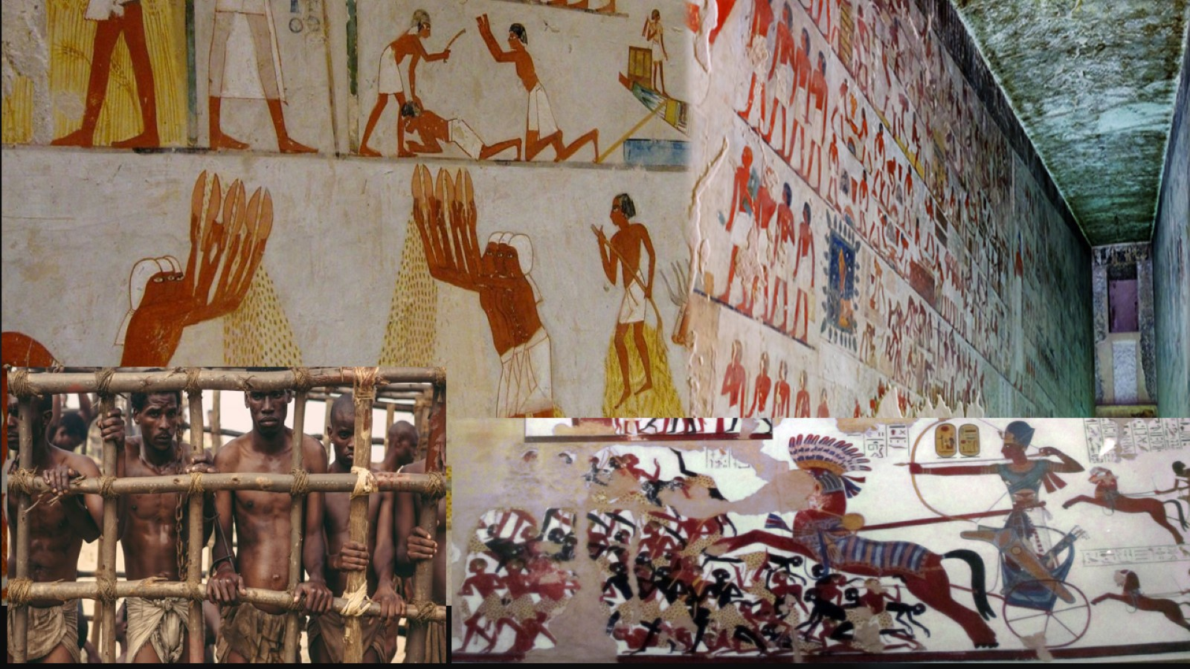

Slide 14
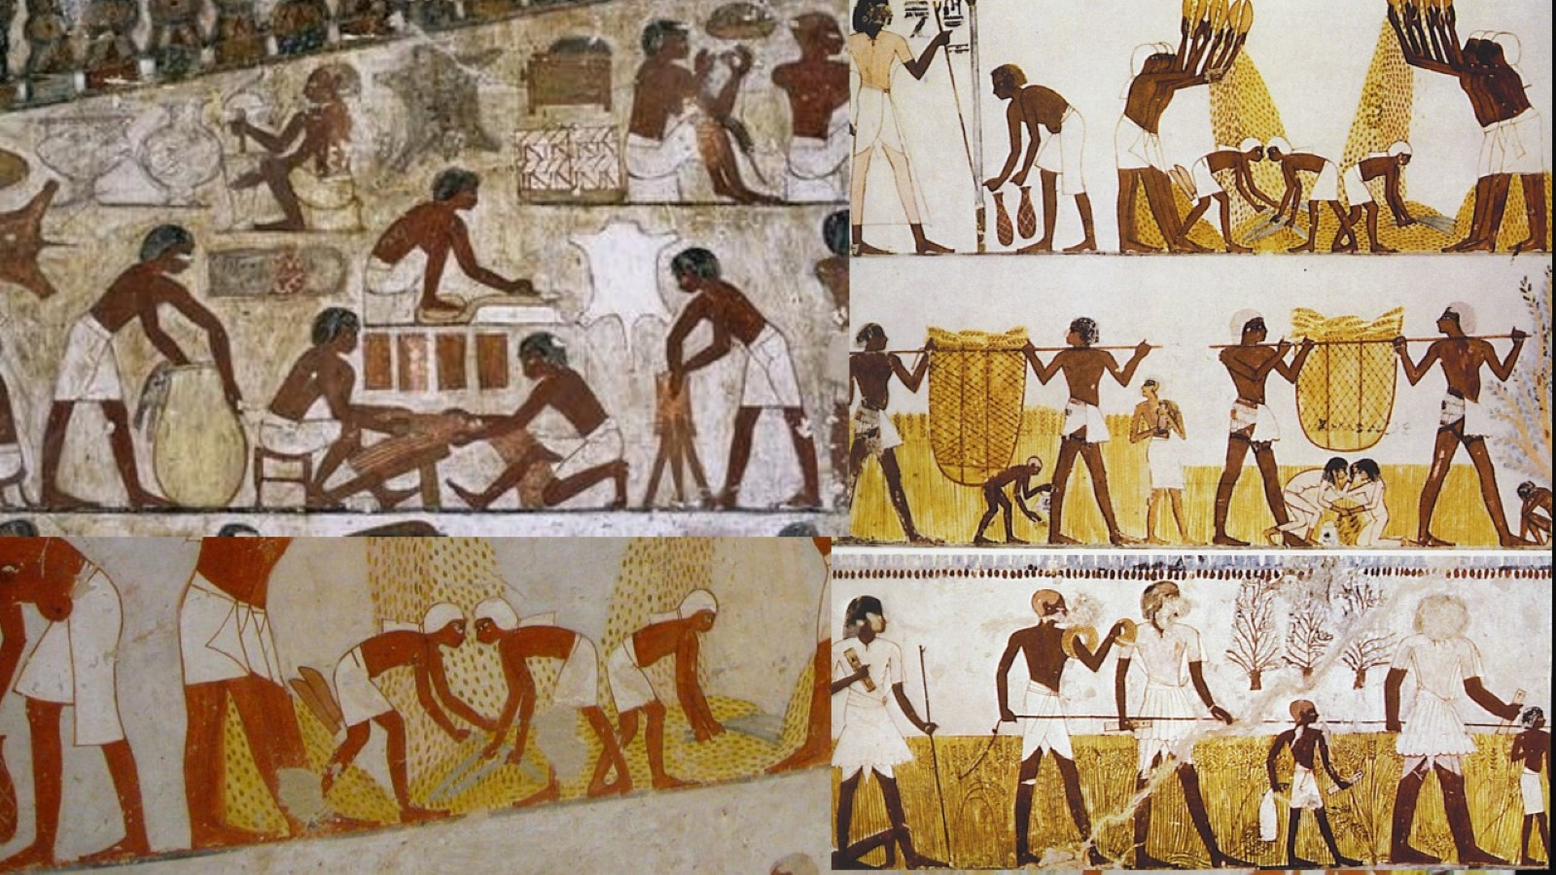

Slide 16
THE DESCENDENTS OF HAM

Slide 18
THE ETHIOPIAN ASPECT

Slide 19
THE ETHIOPIANS ARE COMPARED UNTO ISRAEL

Slide 20
THE AIRLIFT OF THE ETHIOPIAN JEWS, OPERATION SOLOMON MAY 1991

Slide 21
OPERATION SOLOMON, THE ETHIOPIAN JEWS AIRLIFT TO JERUSALEM

Slide 22
ETHIOPIAN JEWS THE REASON FOR OPERATION SOLOMON

Slide 23
ETHIOPIAN JEWS

Slide 24
ACKNOWLEDGMENT OF THE ETHIOPIAN JEWS

Slide 27
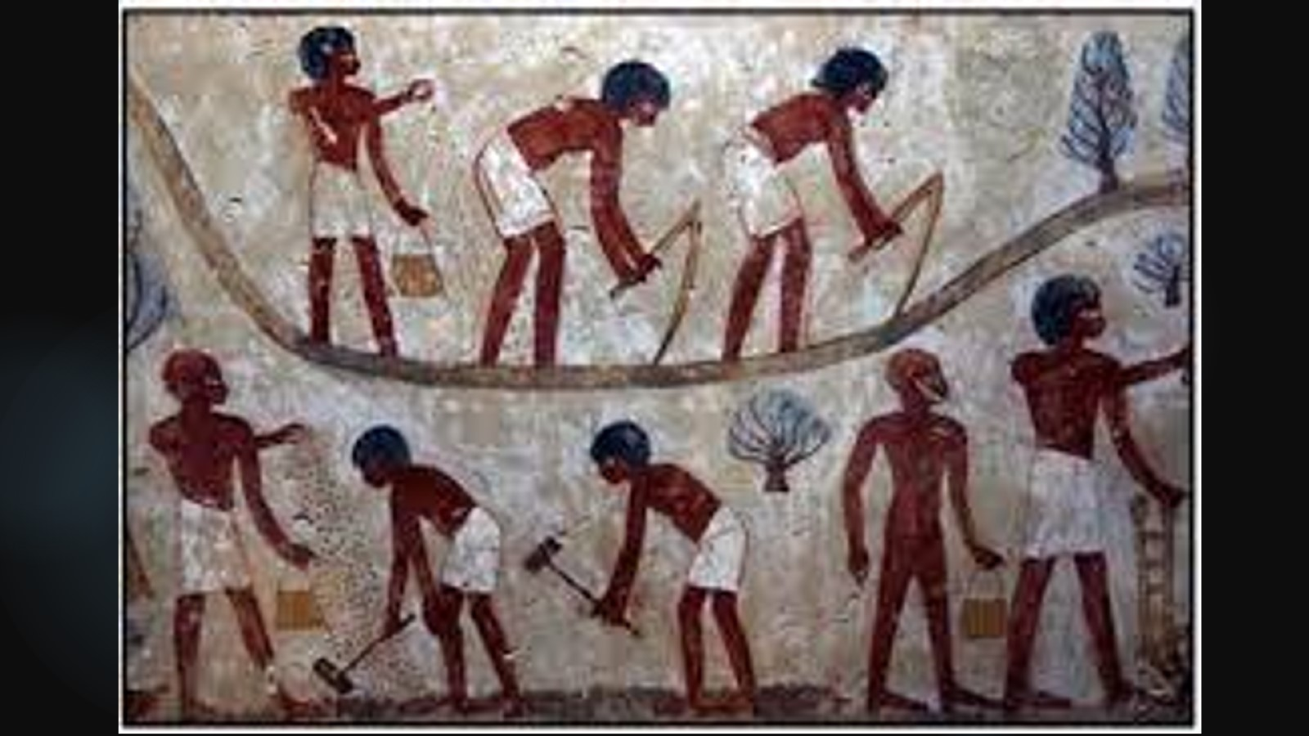

Slide 28
THE COLOR OF MOSES

Slide 30
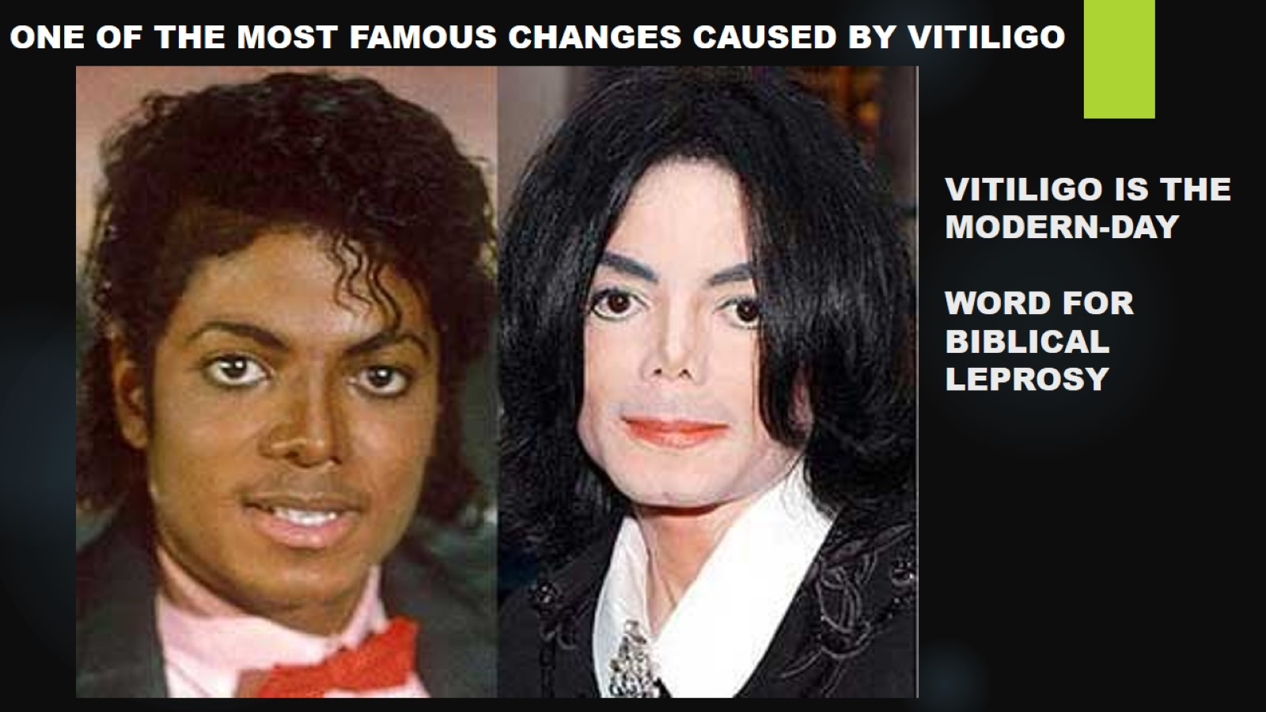
VITILIGO IS THE MODERN-DAY WORD FOR BIBLICAL LEPROSY

Slide 33
THE COLOR OF MOSES SISTER

Slide 35
THE COLOR OF DAVID THE SECOND KING OF ISRAEL

Slide 37
THE COLOR OF THE APOSTLE PAUL

Slide 38
THE COLOR OF JESUS

Slide 39
JOSEPH AND MARY COMMANDED TO HIDE IN EGYPT

Slide 40
THE COLOR OF JESUS

